Slide 1

Gymnasium
Simulator
Be the Alpha!

Slide 2
Gymnasium Simulator
Gymnasium Simulator is a mobile application that provides simulation of exercises for both male and females.
Gymnasium Simulator is based on the idea of self-training
It provides you work-out routines based on you body
If you don’t know your body type, an algorithm is implemented that will determine your body structure

Slide 3
Objectives
Properly guide regular people into the world of fitness.
For our users to do all sorts of training and exercises that will be beneficial for them.
We aim to build awareness regarding the subject of fitness

Slide 4
Scope
Easily accessible to everyone since everyone has a mobile phone.
Target audience are young adults and middle age people, both male and female.
Since 79% of the Gym-goers are under the age of 44.
Our application takes a scientific approach to fitness, exercises are provided to
them, based on their Body structure.

Slide 5
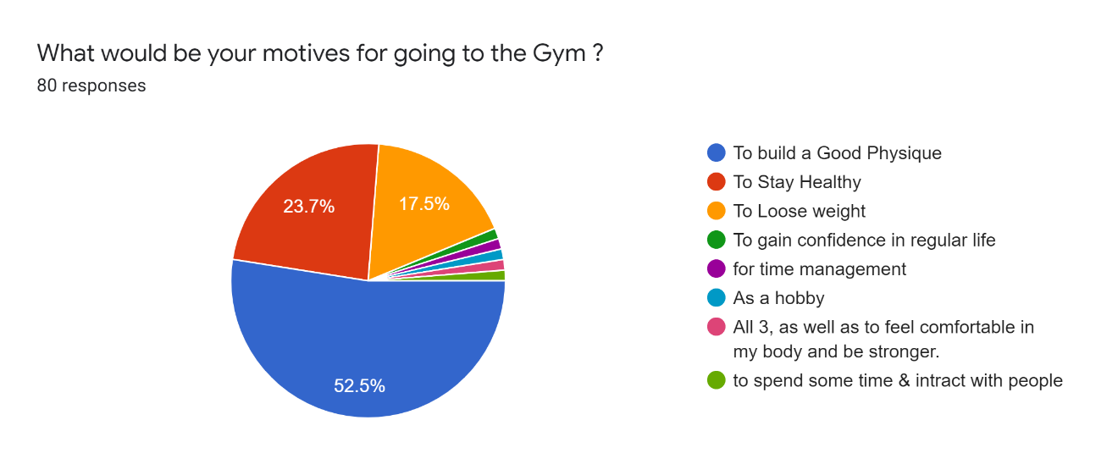
Survey
We conducted a survey to determine the motives behind, people going to the gym.

Slide 6
Application Features
Splash Screens
User Authentication
User Data
Calorie Calculator
Nutrition Calculator
Calories Burned Calculator
Body Recognition
Different Exercises Routine based on individual’s Goal
Scoring

Slide 7

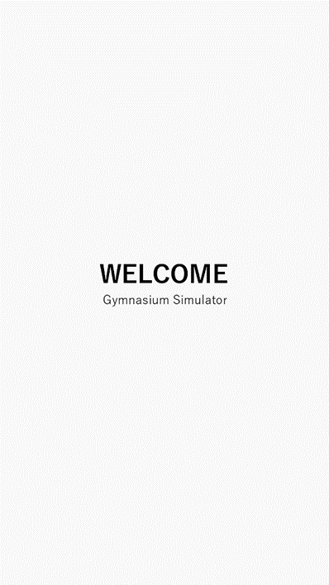
Splash Screen
Splash screen is a screen that is displayed while the application is loading.
We have implemented two splashed screens.
One, when the user opens the App.
Second, when the user logs in.

Slide 8
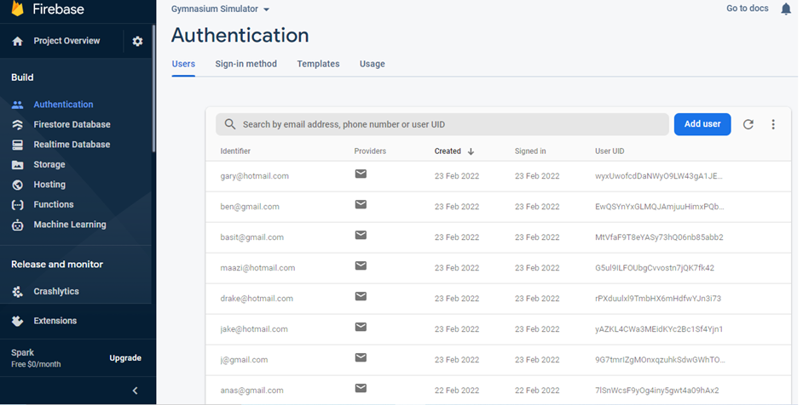
User Authentication
Firebase is being used as a Database. for Authenticating users.

Slide 9
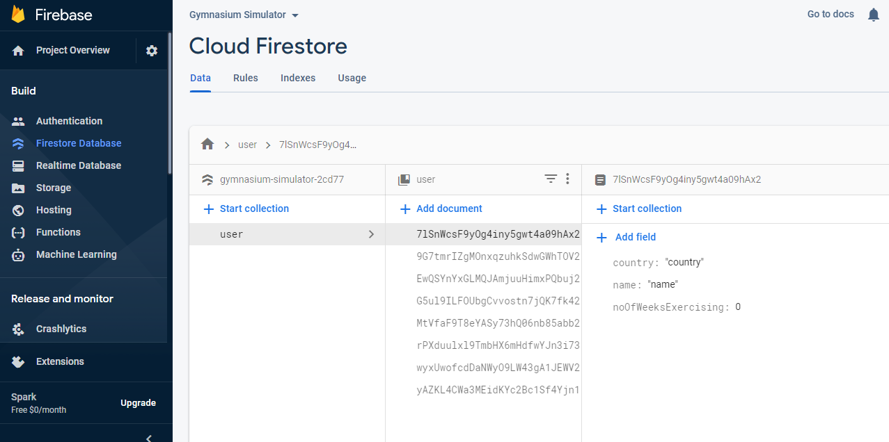
User Data
Cloud Firestore is implemented to store user Data.

Slide 10
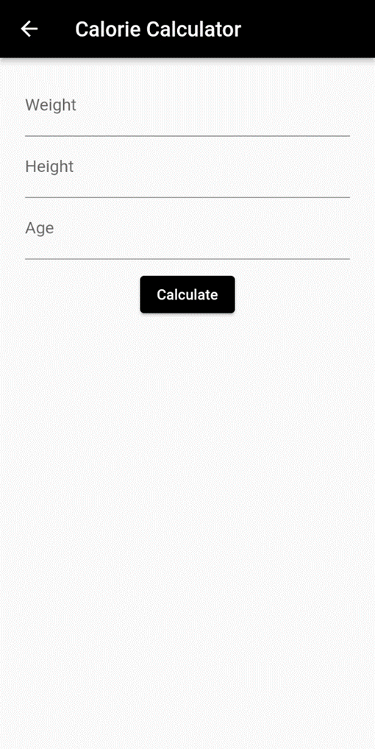
Calorie Calculator
To calculate the Base Metabolic Rate (BMR)
The minimum required calories to performs
basic life-sustaining function
We implement the Revised Harris-Benedict
Equation

Slide 11
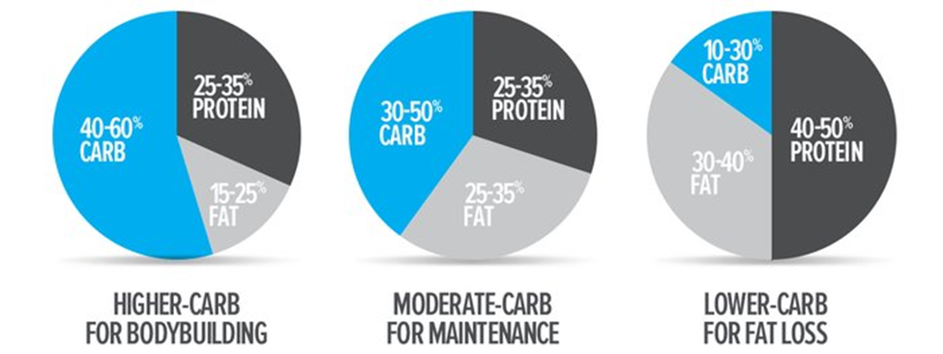
Nutrition Calculator
Nutrition Calculators divide Daily Calorie Intake into 3 macro-nutrients
Carbohydrate Protein Fat

Slide 12
Calories Burned Calculator
Calories Burned Calculator, calculates the calories a person burns
Depending on the Task.
MET(metabolic equivalent of a task) which is the rate at which a person expends energy while performing a task.

Slide 13
Calories Burned Calculator
Cardio
Activity | MET
Walking | 2.5
Running | 8
Cycling | 7.5
Sports | 4.8
Rope Skipping | 12.3
Yoga | 2
Dancing | 5
Swimming | 7.8

Slide 14
Calories Burned Calculator
Gym Activities
Activity | MET
Calisthenics | 3.8
Resistance Training | 3.5

Slide 15
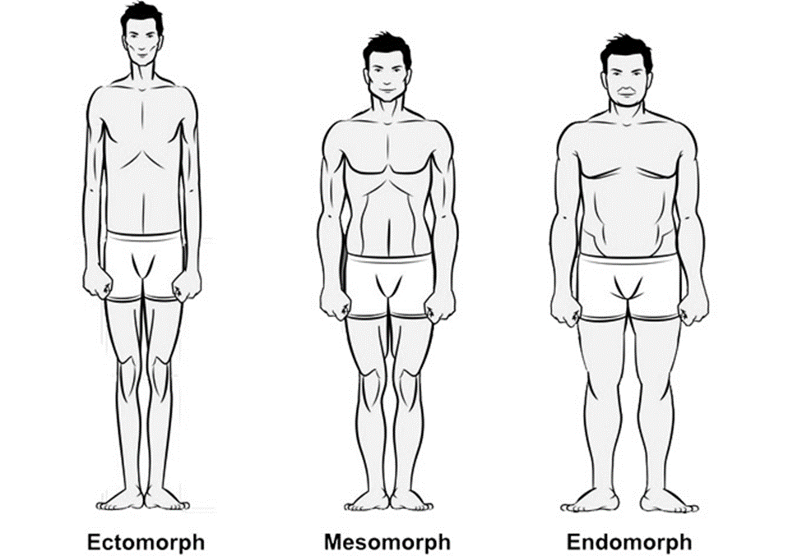
Body Recognition
In 1940, Dr. W.H. Sheldon, classified the human body into three different body types.
These body types are based on bone structure,
joint ratios, and body composition.

Slide 16
Body Recognition
Endomorph
Broad and sturdily bone structures
Larger midsection and hips
Carries more fat
Faster fat gain
Slower fat loss
Slow metabolism
Ectomorph
Narrow shoulders
Narrow hips
Smaller muscles
fast metabolism
Mesomorph
Shoulders wider than the hips
Athletic
Efficient metabolism
Muscle gain with relative ease
Fat loss with relative ease

Slide 17
Body Recognition
We trained a model to recognize Endomorph, Ectomorph, Mesomorph for both
male and female.
After training the model we implemented it within our Application.
Endomorph
Broad and sturdily bone structures
Larger midsection and hips
Carries more fat
Faster fat gain
Slower fat loss
Slow metabolism

Slide 18
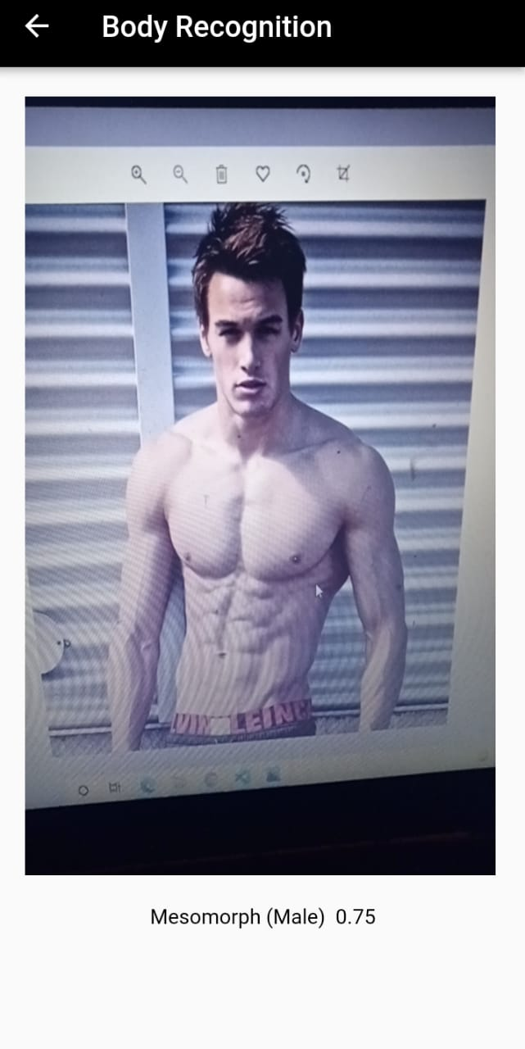
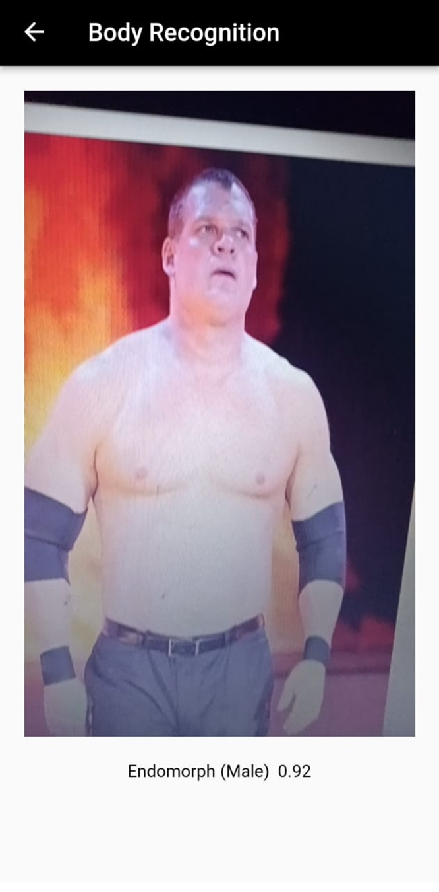
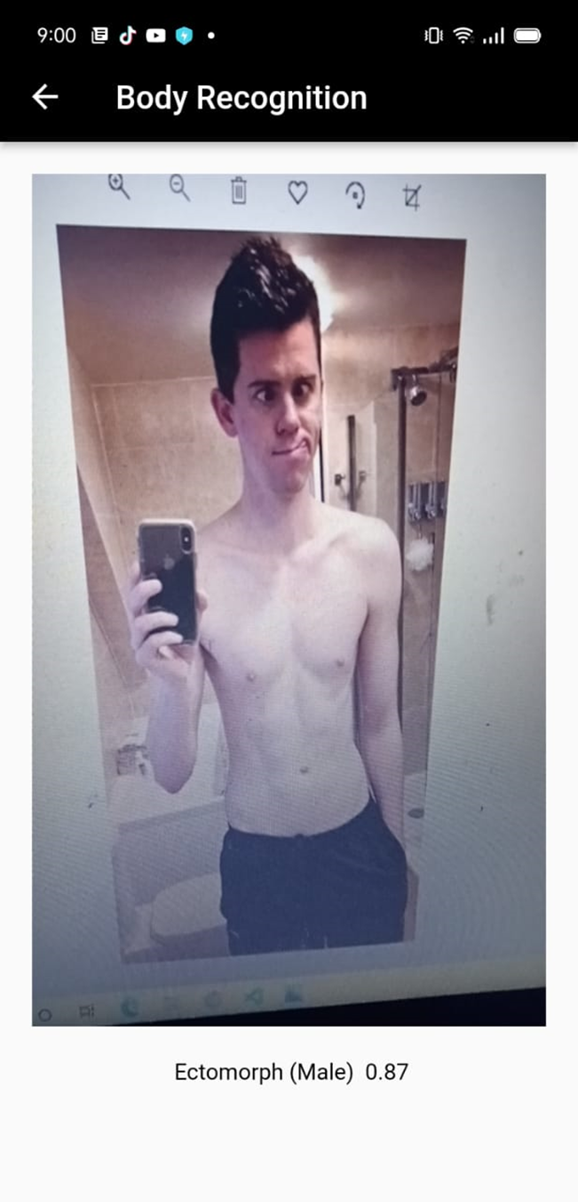
Endomorph
Broad and sturdily bone structures
Larger midsection and hips
Carries more fat
Faster fat gain
Slower fat loss
Slow metabolism

Slide 19
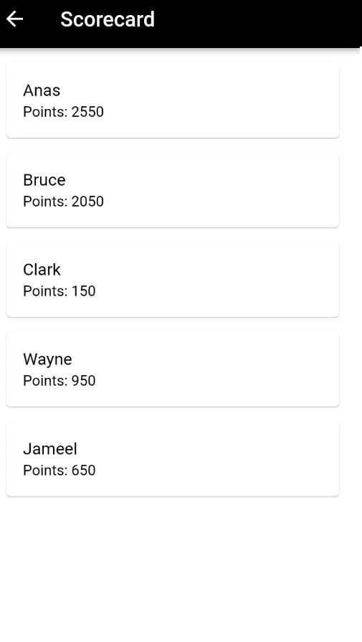
Score
Scoring system is connected to Firebase
It Assigns Points based on User Data

Slide 20
Block Diagrams
DFD
ERD
Activity Diagram
Use Case Diagram

Slide 21
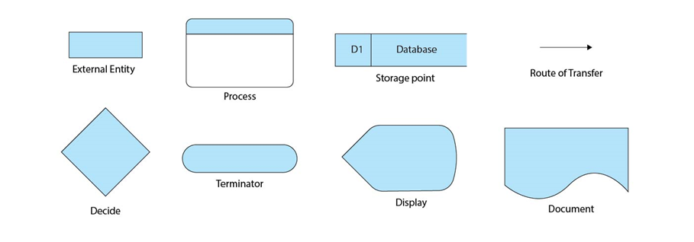
Data Flow Diagram
(DFD) is used to maps out the flow of data.
It uses symbols like rectangles, circles, arrows and text labels, to graphically represent data inputs, outputs, data depository points and routes between each station

Slide 22
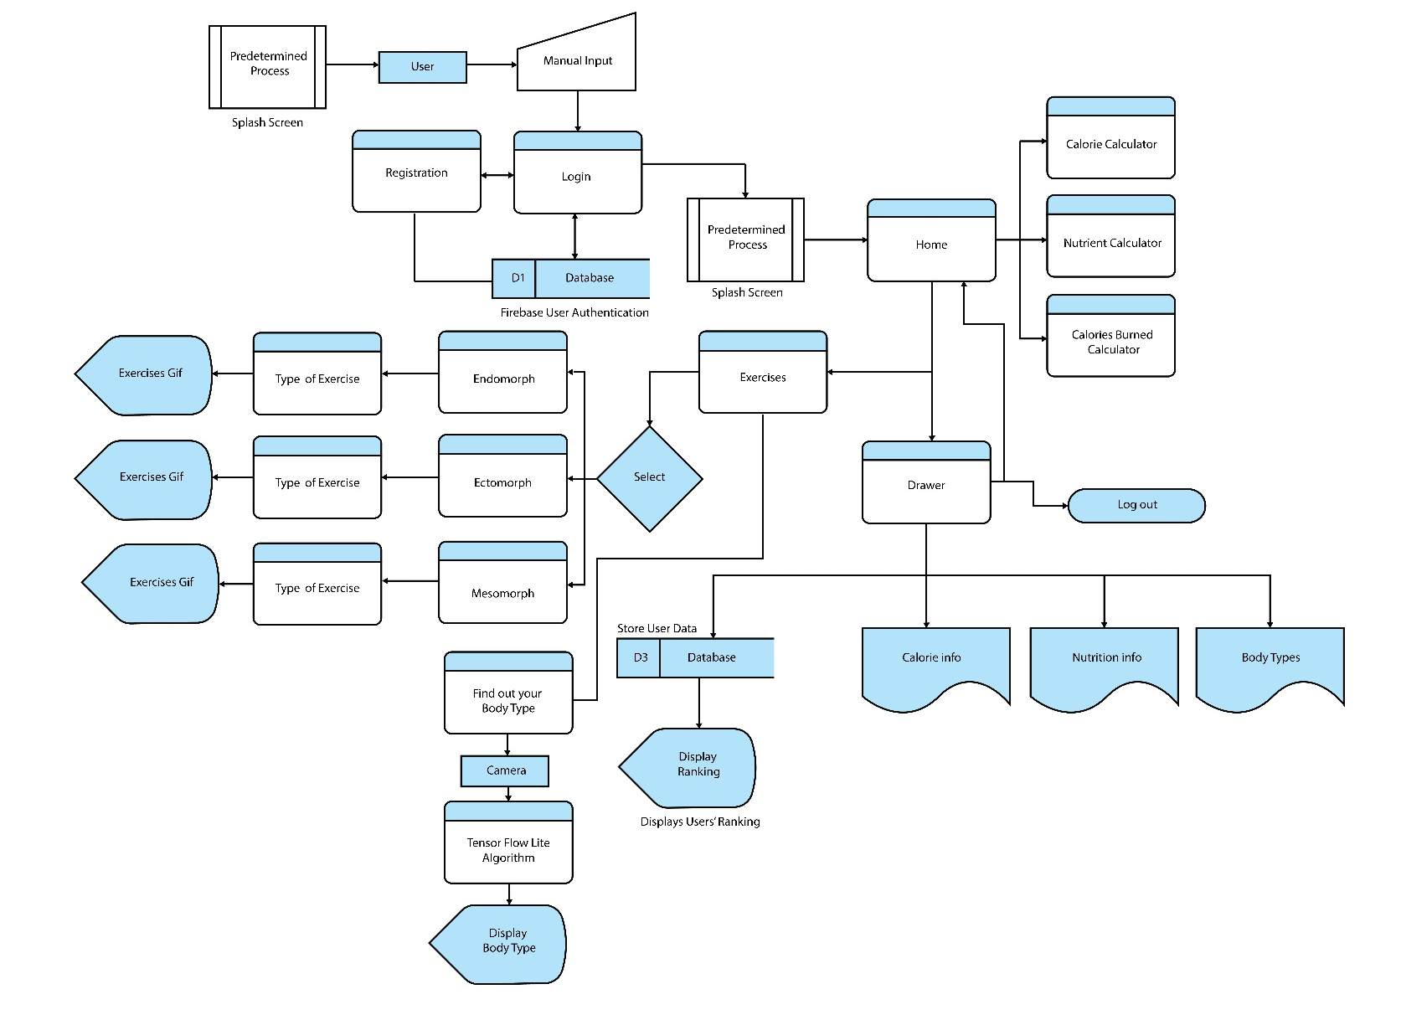

Slide 23
Entity Relationship Diagram
ER Diagram, is a form of flowchart that demonstrates how Entities (people, objects or
concepts) relate with each other in a system.
We have created an ER diagram below, in which User, Login, Register, BodyType, Body
Detection, Exercises, Calories, Calories Burned and Nutrients are Entities and the relation
between them is illustrated.

Slide 24
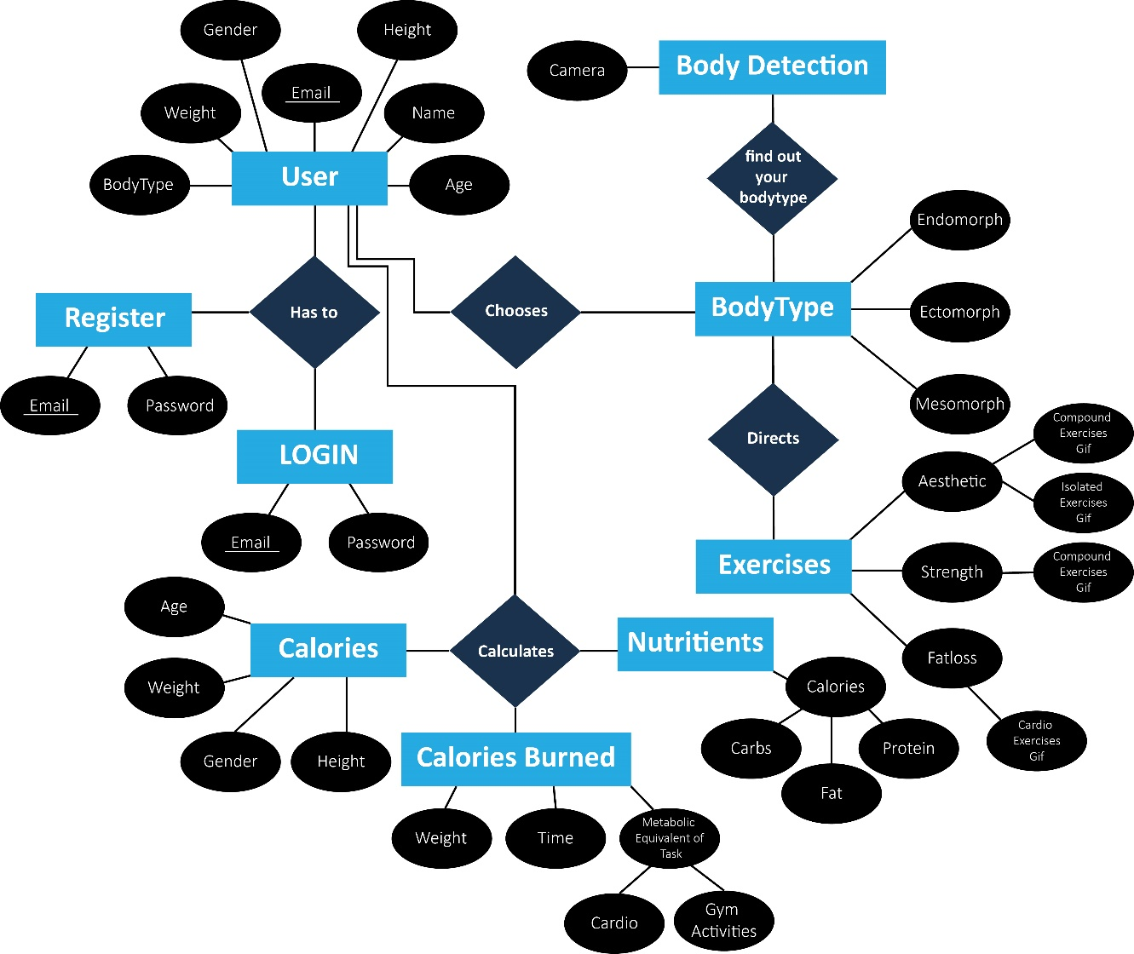

Slide 25
Activity Diagram
An activity diagram, depicts the behavior of a system or a program.
It sketches the control flow from a start to end point, displaying several decision paths that
exist when an activity is executed.

Slide 26
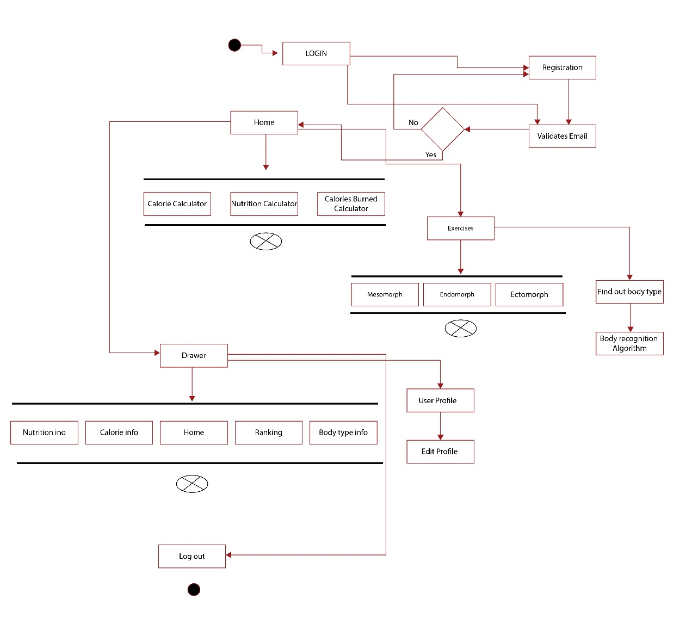

Slide 27
Use Case Diagram
Use case diagram provides a graphical illustration of the interactions between user and the
system.
It demonstrates the interaction without elaborating on working details of each function.

Slide 28
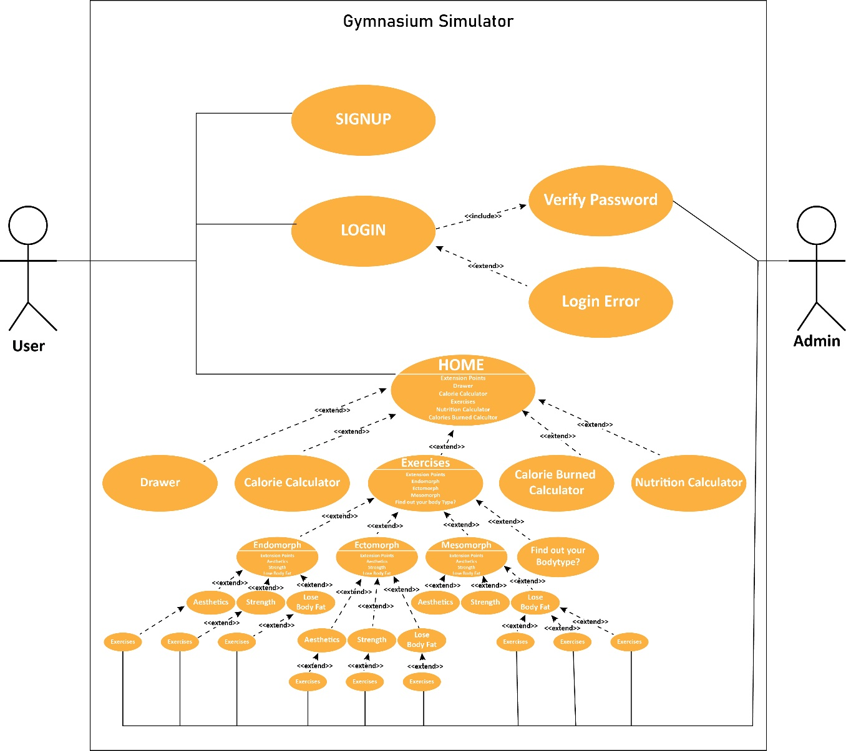

Slide 29
Technical Documents
Stakeholder Register
Risk Register
Gantt Chart

Slide 30
Stakeholder Register
 | Name | Role | Power | Interest | Needs & Wants | Concerns
1 | Huma Hasan Rizvi | FYP team (In charge) | High | Low | Submission of complete project | -
2 | Mohsin Vohra | Advisor | High | High | Completion of Project & Report | Project shouldn’t deviate from proposal
3 | Muhammad Anas | GL, Programmer | High | High | Wants to complete coding element | Project complete successfully
4 | Daniyal Nazar | Designer | Low | High | Wants designs to be accepted | Designs being rejected
5 | Zuhair | Animator | Low | High | Wants animation to be accepted | Animation not working
6 | Sameer Khan | Writer | Low | High | Wants to complete the report | Plagiarism being high

Slide 31
Risk Register
Document which records identified risks
Likelihood of their occurrence
Consequences of those risk
The actions being taken to reduce those risks
Who is responsible for managing them.
5 | 5 | 10 | 15 | 20 | 25
4 | 4 | 8 | 12 | 16 | 20
3 | 3 | 6 | 9 | 12 | 15
2 | 2 | 4 | 6 | 8 | 10
1 | 1 | 2 | 3 | 4 | 5
 | 1 | 2 | 3 | 4 | 5
Y-Axis: Probability X-Axis: Impact

Slide 32
Risks | Impact | Impact Level | Probability Level | Priority Level | Mitigation Level | Owner
Description of the risk | Consequence of the risk | 1 [Low] to 5 [Hight] | 1 [Low] to 5 [Hight] | [Impact x Probability] Address Highest First | Actions taken to reduce or eliminate ricks | Who’s Responsible?
Asynchronous Data Transmission Error | User info not being edited, not being displayed | 5 | 3 | 15 | Making sure there is no error in setting up the stream of Async data | Muhammad Anas
Navigating to different screens | User clicks on register and gets directed to Exercises page | 2 | 4 | 8 | Provide the correct route in every button | Muhammad Anas
Animations not working | Exercises Gif don’t Play | 5 | 1 | 5 | Making sure Gif work | Zuhair
Graphical Elements size too large or too small | Graphics elements not aligning properly | 2 | 5 | 10 | Resizing considering the display screen of the phone | Daniyal Nazar
High Plagiarism | lower grade | 5 | 5 | 25 | Paraphrasing & referencing | Sameer Khan

Slide 33
Gantt Chart
Tasks | Aug 2021 | Sep 2021 | Oct 2021 | Nov 2021 | Dec 2021 |  | Jan 2022 | Feb 2022
Animation | Exercises Gif
Graphical Elements | Logo, Poster, Brochure |  |  | DFD, Activity, Er, Use Case & Pitch Deck Vide
User Interface |  | Created on Flutter Framework with Dart as the programming Language
User Authentication, Update User Data |  |  |  | Firebase Authentication & Cloud Firestore
Body Recognition |  |  |  |  | Tensor Flow lite
Report Writing & Research Paper |  |  |  |  |  |  | Latex for Report and Word for Research Paper

Slide 34
Cost & Conclusion
Cost Breakdown
Conclusion
Limitation
Future Work

Slide 35
Cost
The project overall costed us around 55,000 Pakistani rupees
Soft/ware / Hardware | Cost
Graphic Card | 20,000
SSD | 10,000
Adobe Illustrator | 11,132
Documentation | 14,000

Slide 36
Conclusion
In conclusion, we’ve developed an application that serve the purpose of being an ultimate
guide for beginner weight lifters. There are several functionalities that will help and guide
users toward achieving their ideal physique and being healthy.

Slide 37
Limitations
The application is only limited to a certain types of audience.
It’s restricted to android only. Windows version of Flutter isn’t compatible with iOS
Needs an Internet connection to retrieve all the data.
TF-lite model isn’t smart enough to redirect users to exercises just by scanning their body.

Slide 38
Future Work
Nutrition calculator of individual food item could be implemented
Food items barcode scanner that provides the calories and nutrition background of that item and also stores it in memory.
Steps Calculator
Body Fat Calculator
Could be shifted to the iOS platform.

